Slide 1
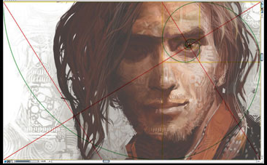
Golden Rectangle Symmetry
Michael S. Schneider www.constructingtheuniverse.com

Slide 2
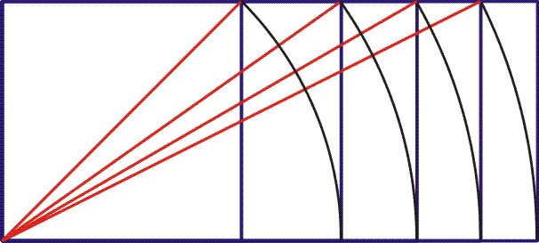
Golden Rectangle
1
1.618…

Slide 3
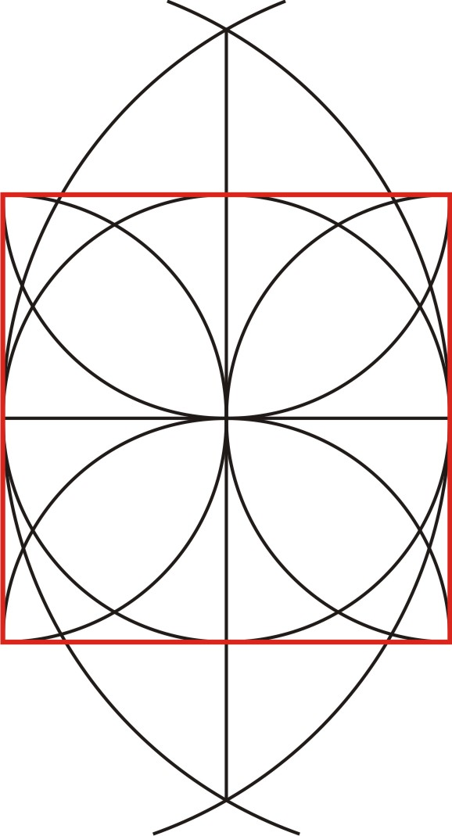
Page 91
To construct a
Golden Rectangle
start with a square.

Slide 4
1
1

Slide 5
Drawing this red line isn’t necessary – it just shows where to open the compass between.
Midpoint

Slide 7
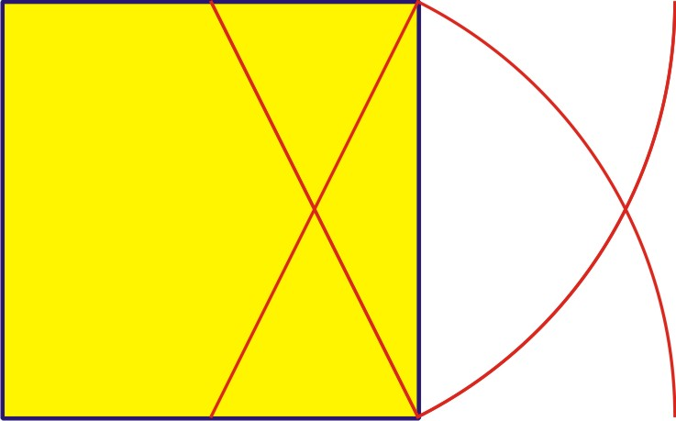
Make an arc in the upward direction too!

Slide 8
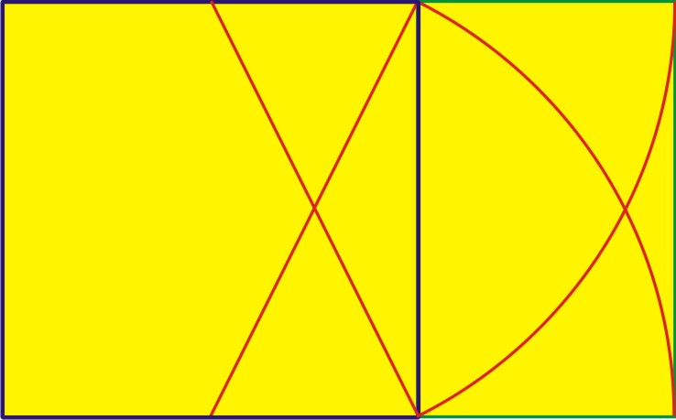
The whole is a large Golden Rectangle.
And this small rectangle added onto the square is a small Golden Rectangle!
1
1
.618

Slide 9
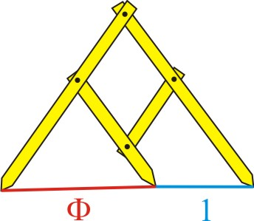
Golden Ratio Calipers
1
.618
1

Slide 10
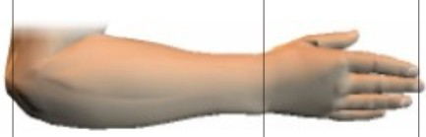
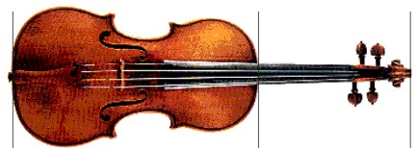
Page 98
Golden Ratio Calipers

Slide 11
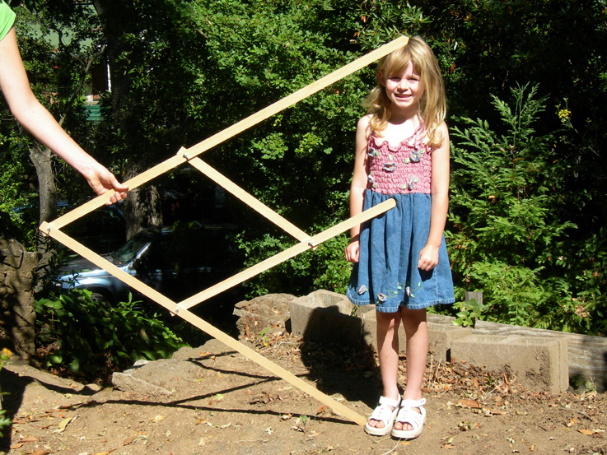
.618
1

Slide 12
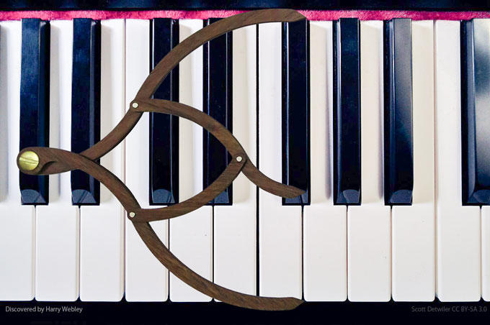

Slide 13
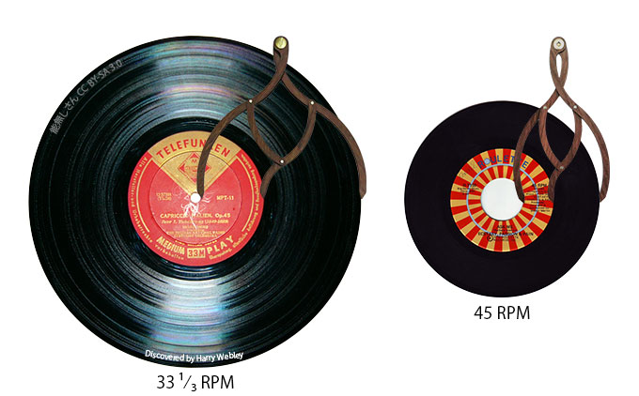

Slide 14
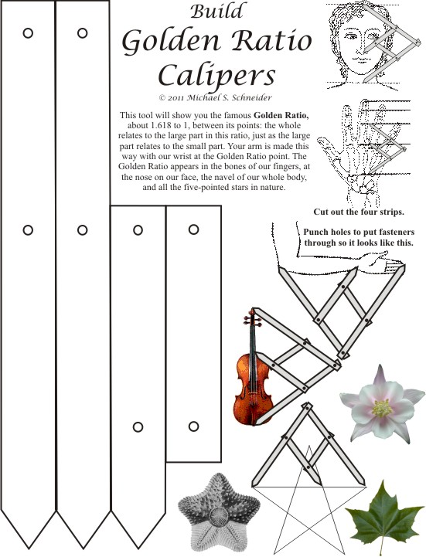
Page 98
1.618
1.618
1.618
1.618
2.618
2.618
1

Slide 15
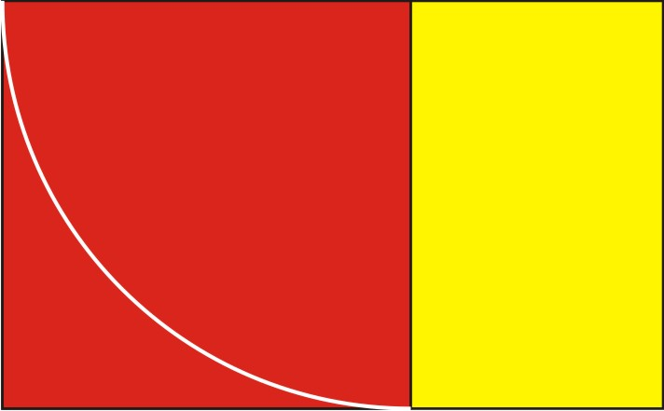
The Golden Rectangle
is also known as
the rectangle of “whirling squares”
because drawing a square in a Golden Rectangle
always leaves a smaller Golden Rectangle.

Slide 16
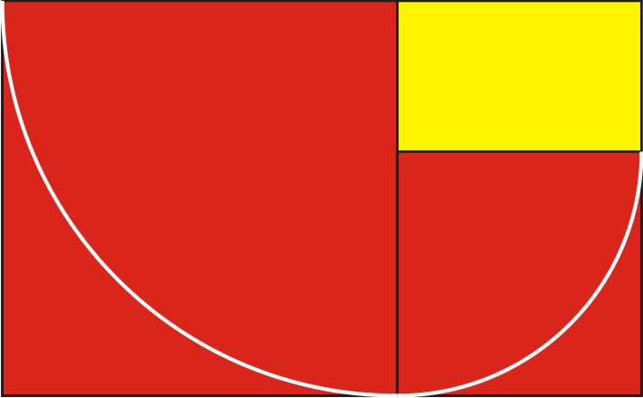

Slide 17
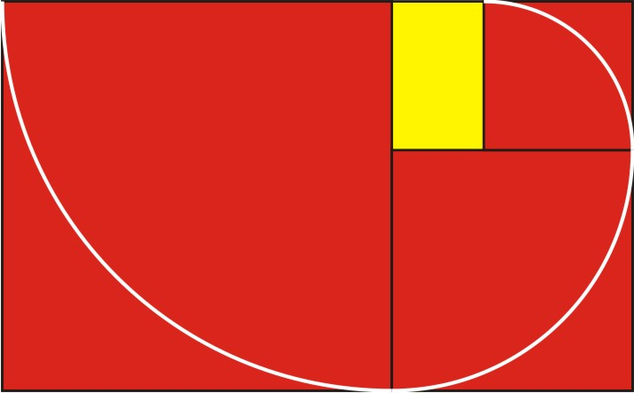

Slide 18
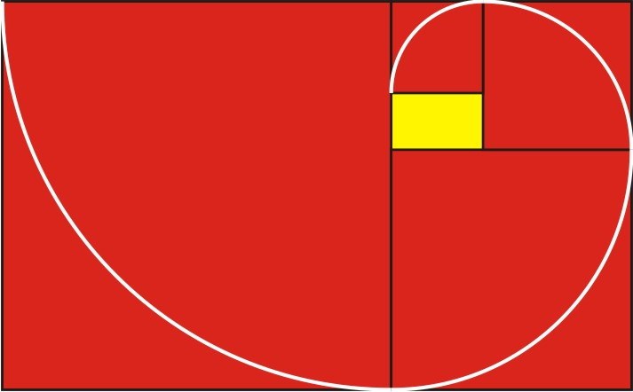

Slide 19
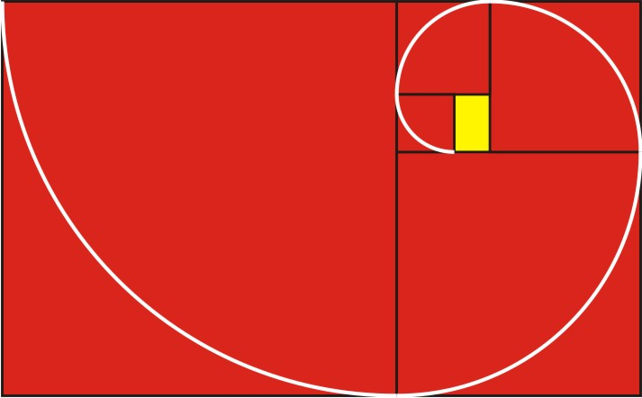

Slide 20
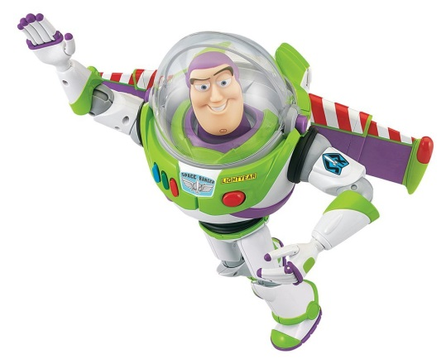

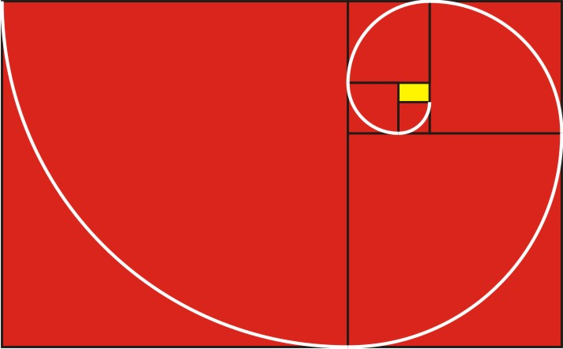
“To infinity
and beyond!”
-- Buzz Lightyear

Slide 21
You can find the spiral’s “eye” without drawing the spiral.
Just draw the diagonals of
the full Golden Rectangle
and a smaller Golden Rectangle

Slide 22
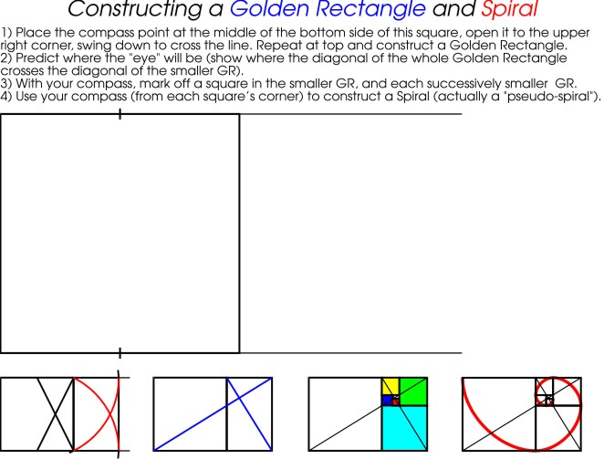
Page 91

Slide 23
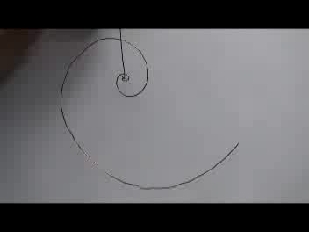
A Golden Spiral balances in the same way no matter it’s size!

Slide 24
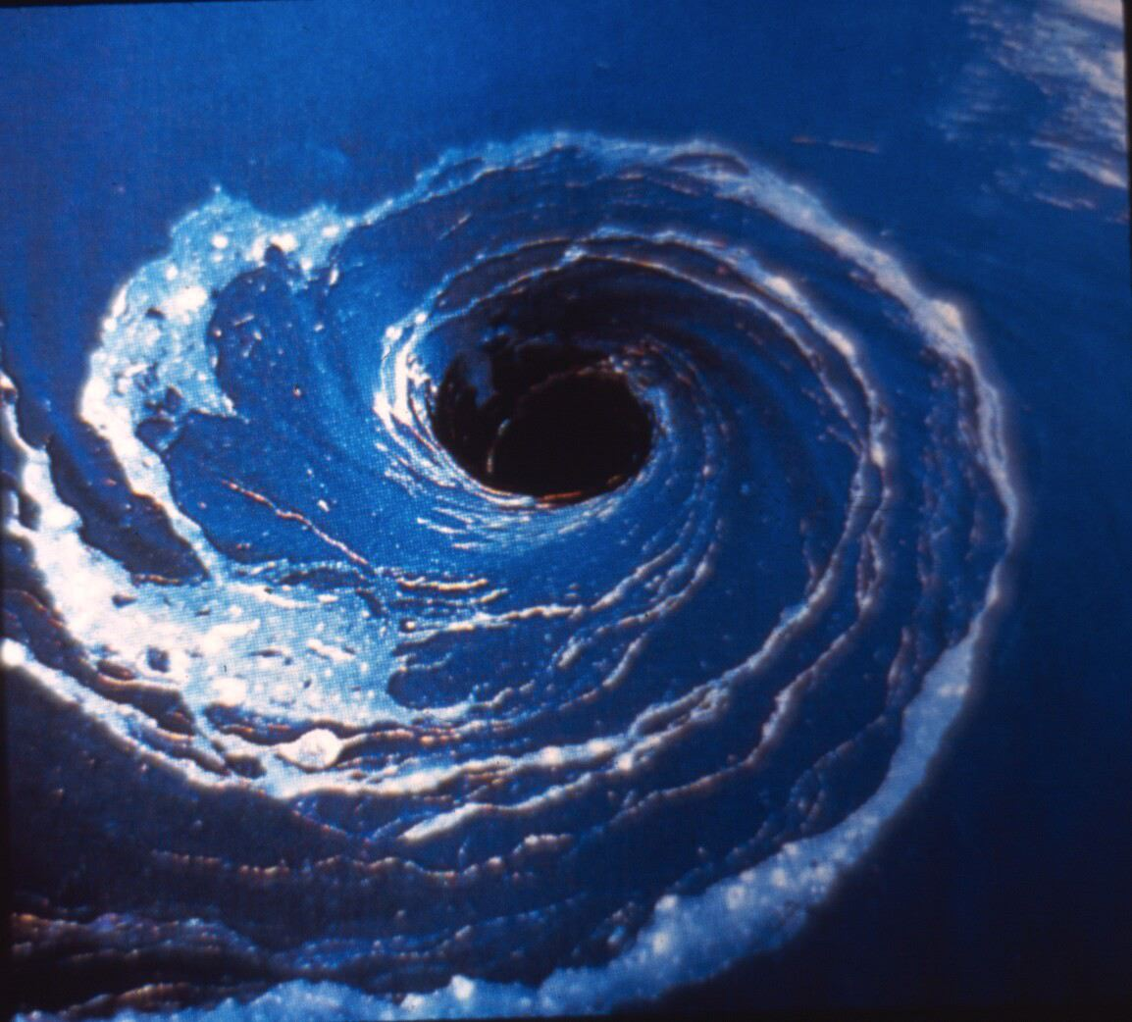

Slide 25
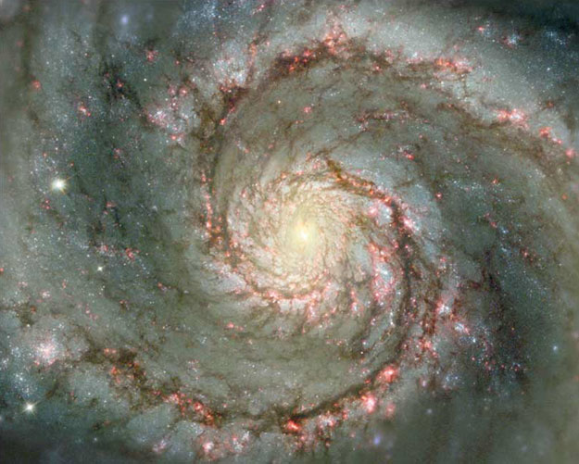

Slide 26
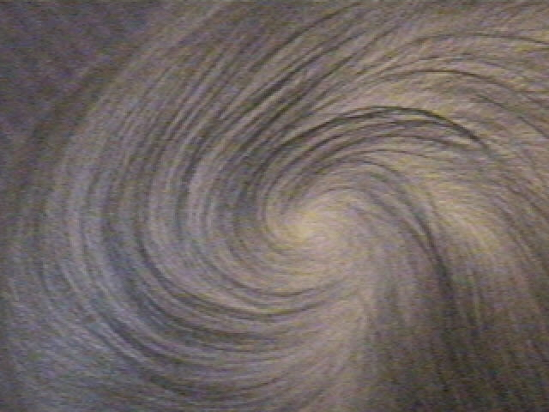

Slide 27
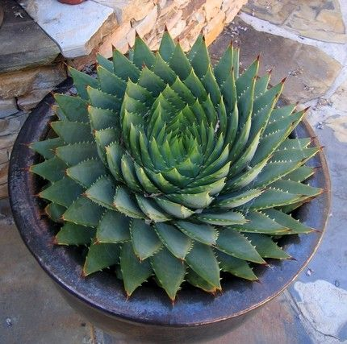

Slide 28


Slide 29


Slide 30
Page 92

Slide 31
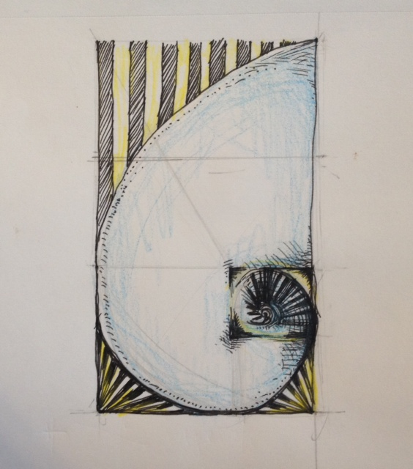
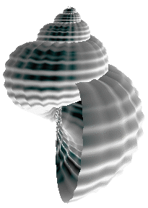
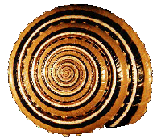
devon matlock

Slide 32
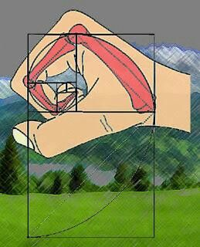
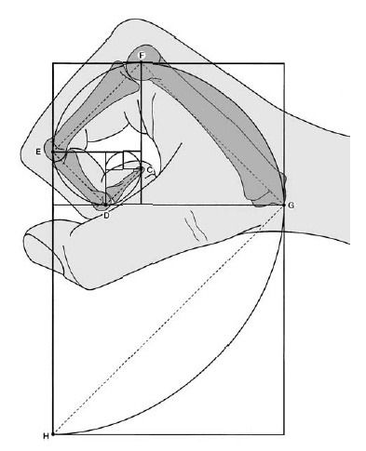

Slide 33
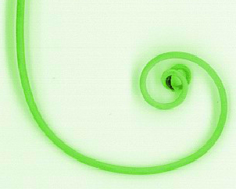
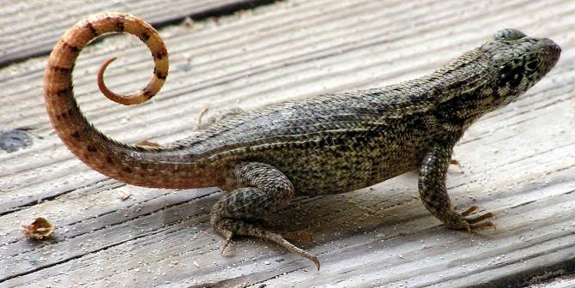
Pea Tendril
Growing size &
greater weight,
but the same balance!

Slide 34
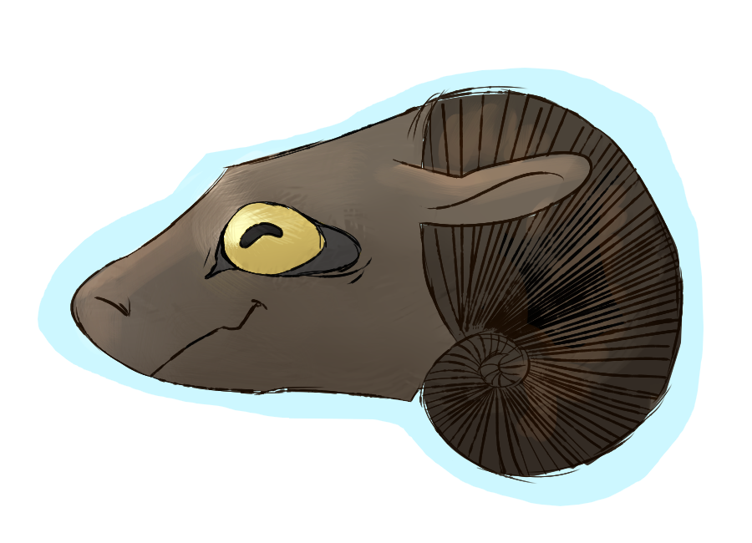
angela chong

Slide 35
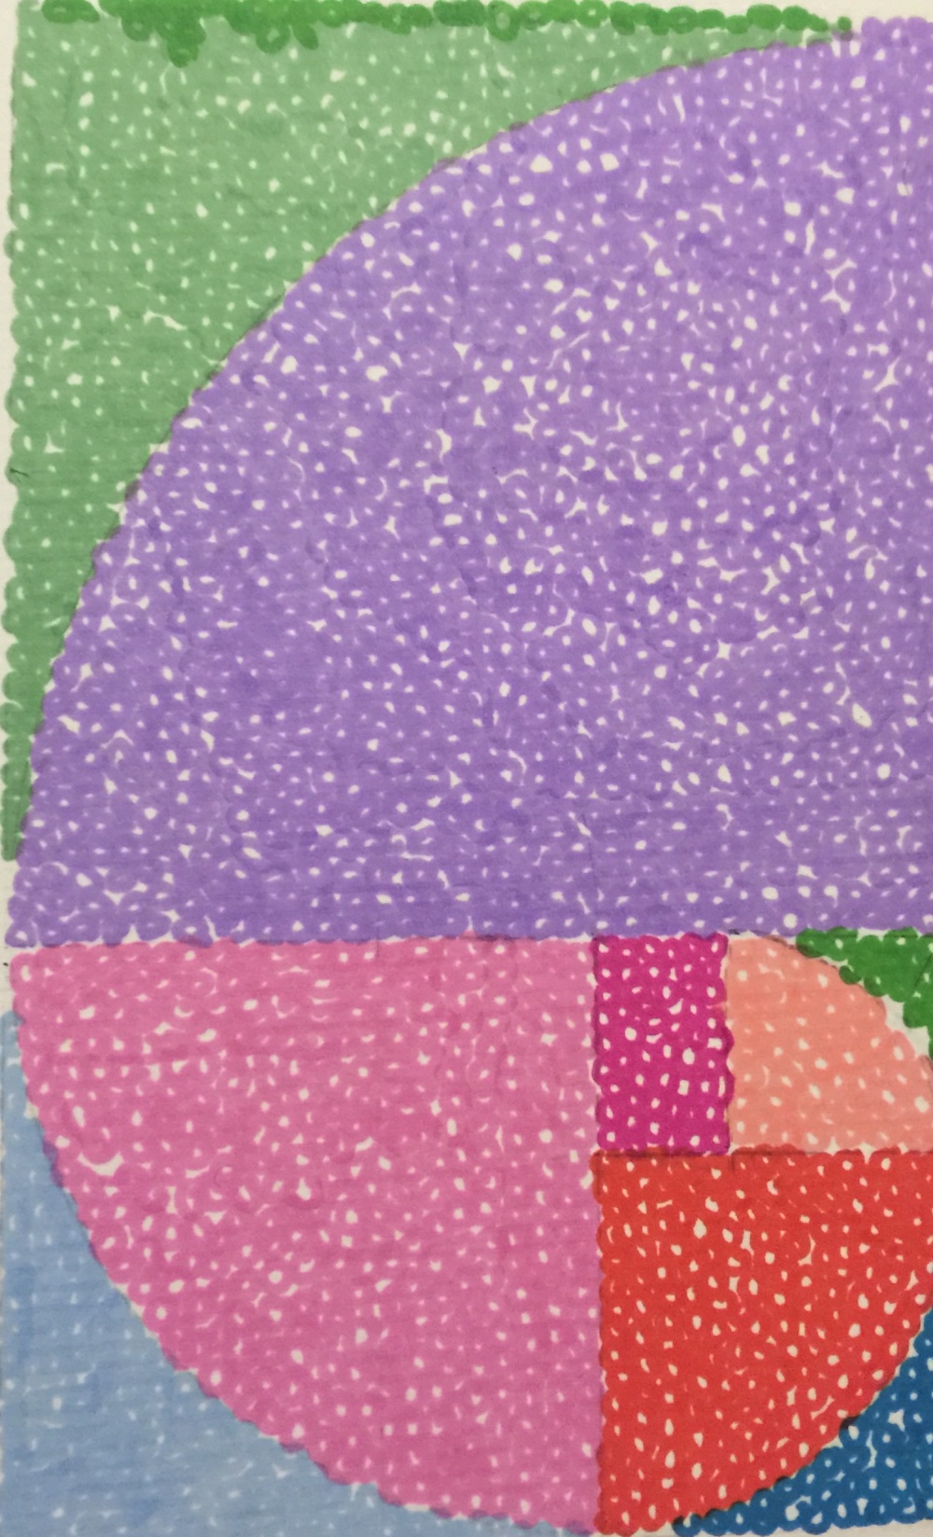
Cynthia Mao

Slide 36
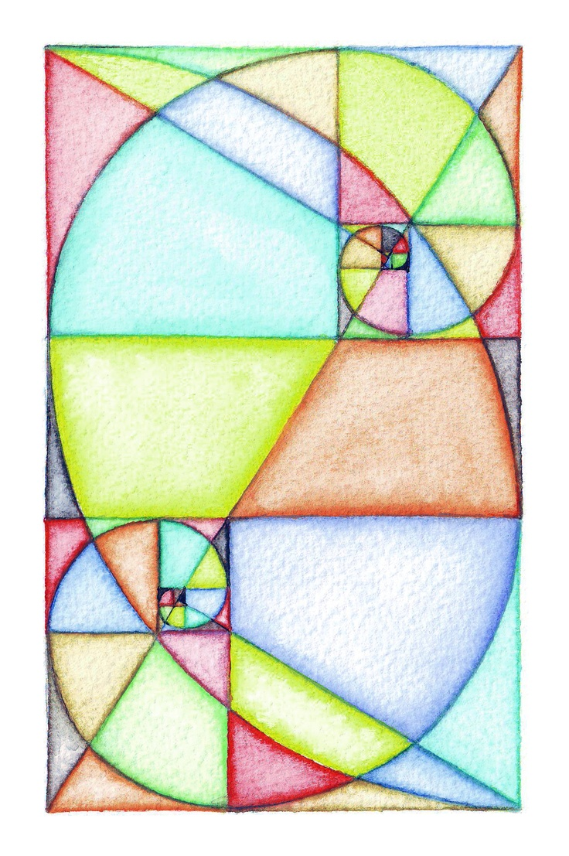

Slide 37
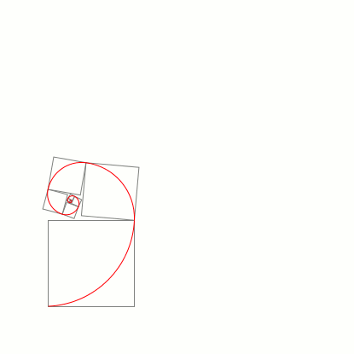

Slide 38
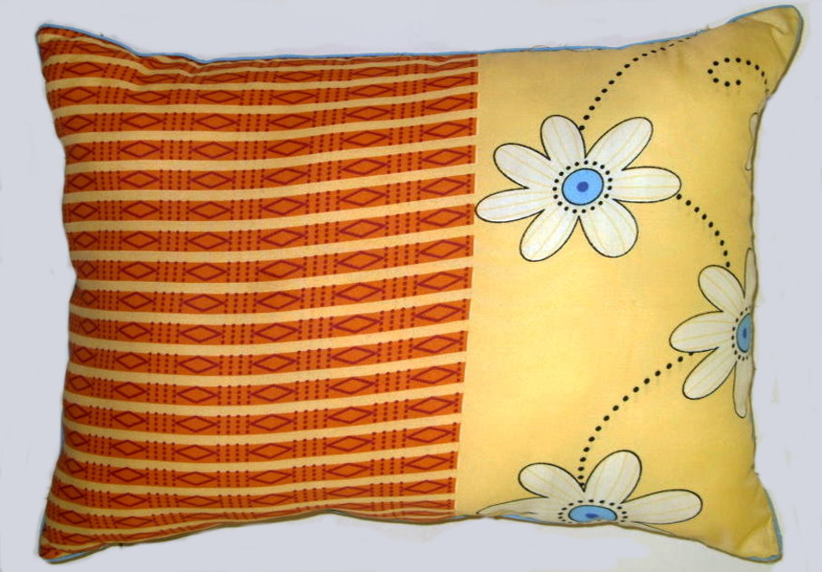

Slide 39
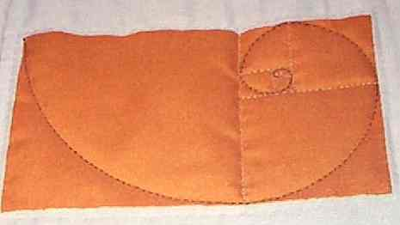
Quilt

Slide 40
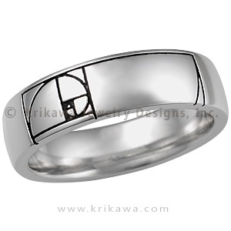
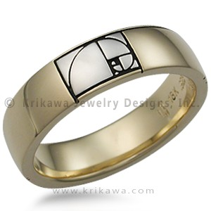
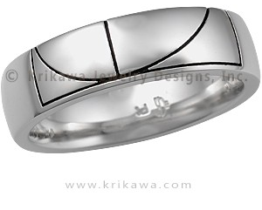

Slide 41
Page 93
Visual Center of Gravity, a Point of “Balance”
Whatever you put there seems to stand out in the picture.

Slide 42
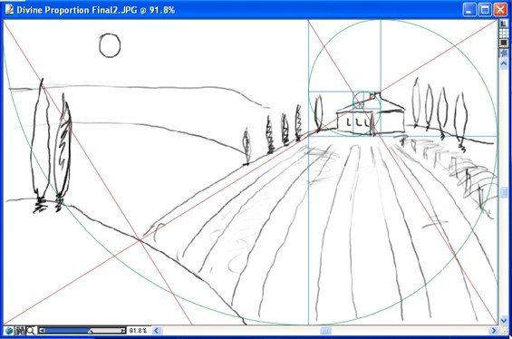
Page 94
The house is intended to be the visual center of gravity

Slide 43
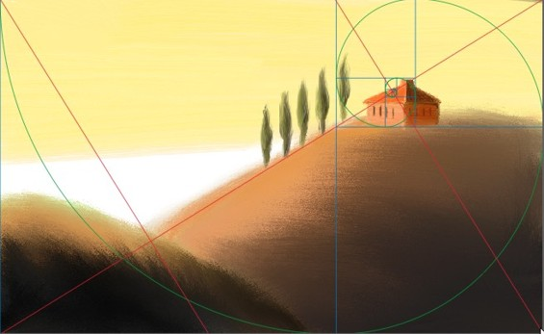
Page 94

Slide 44
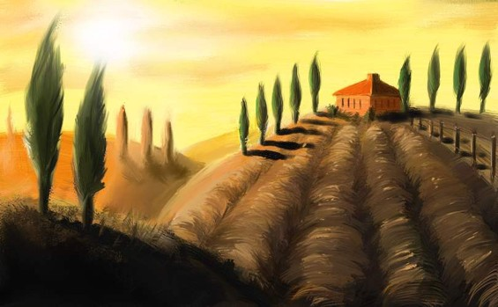
Page 94

Slide 45
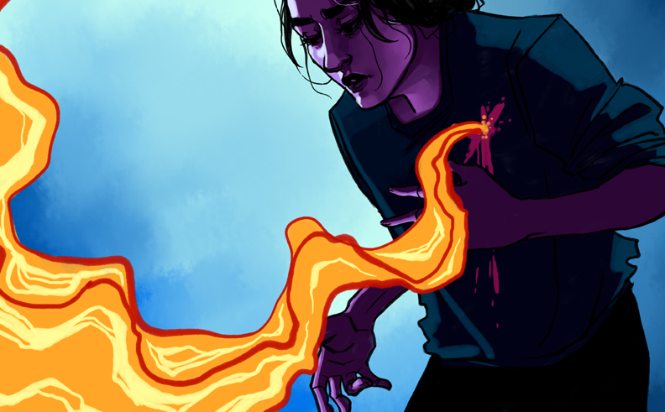
Page 93

Slide 46
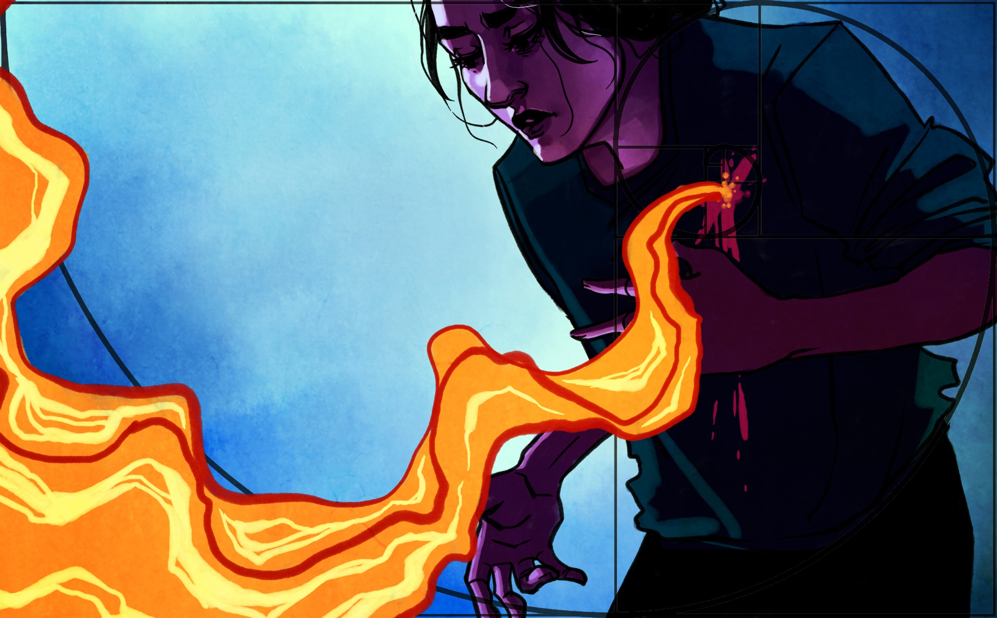
Page 93

Slide 47
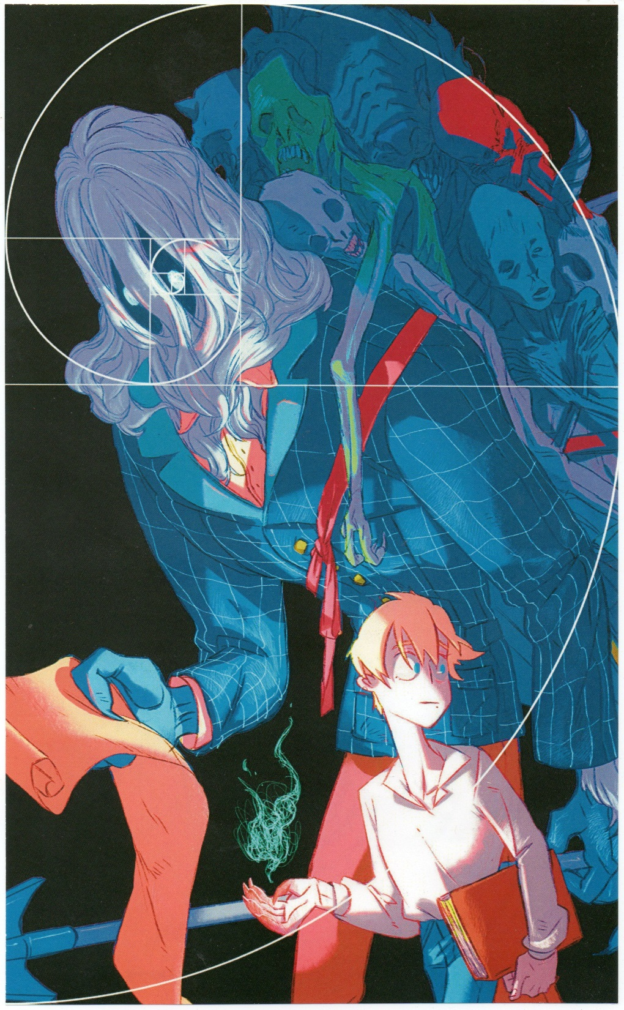

Slide 48

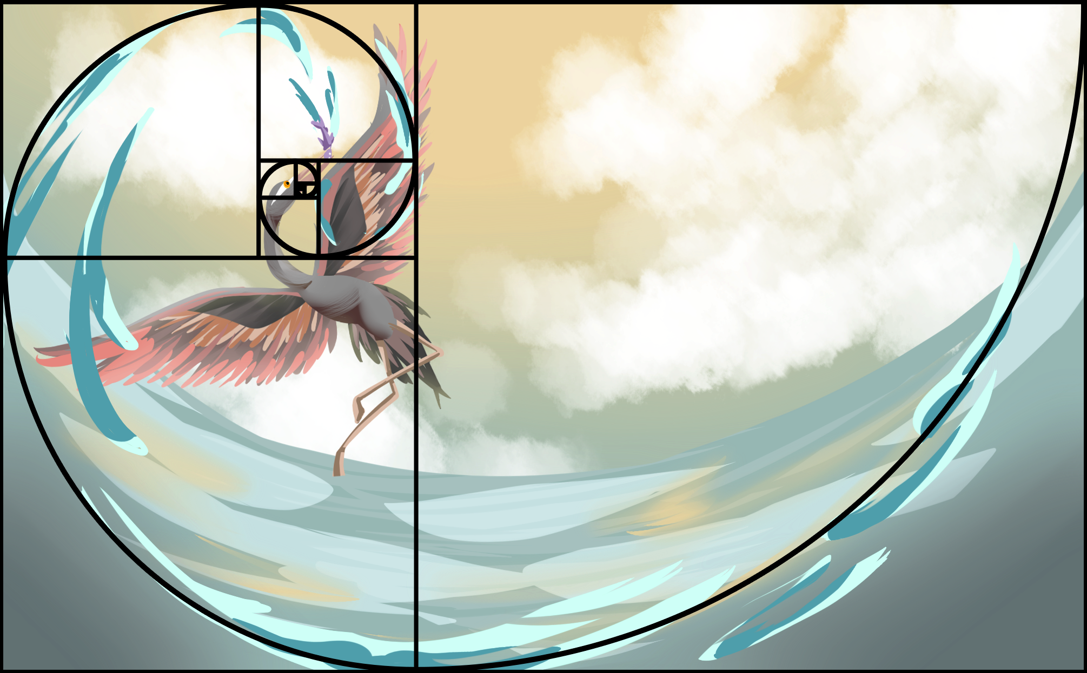

Slide 49
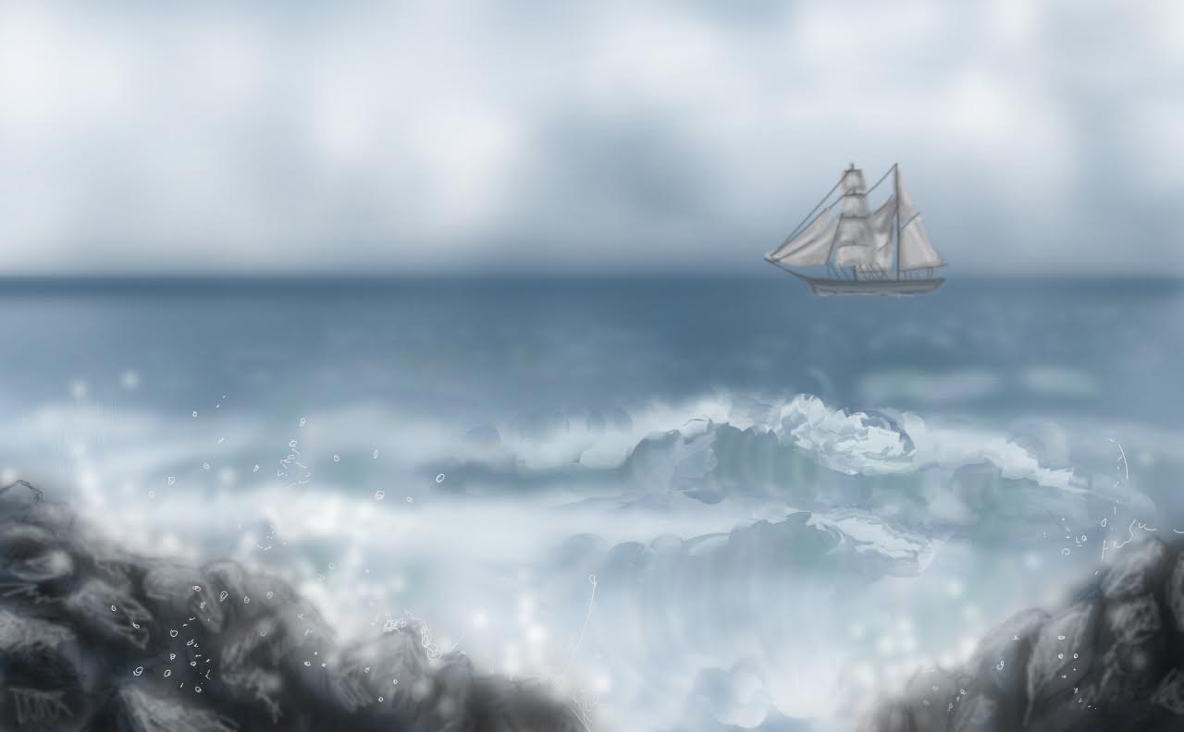
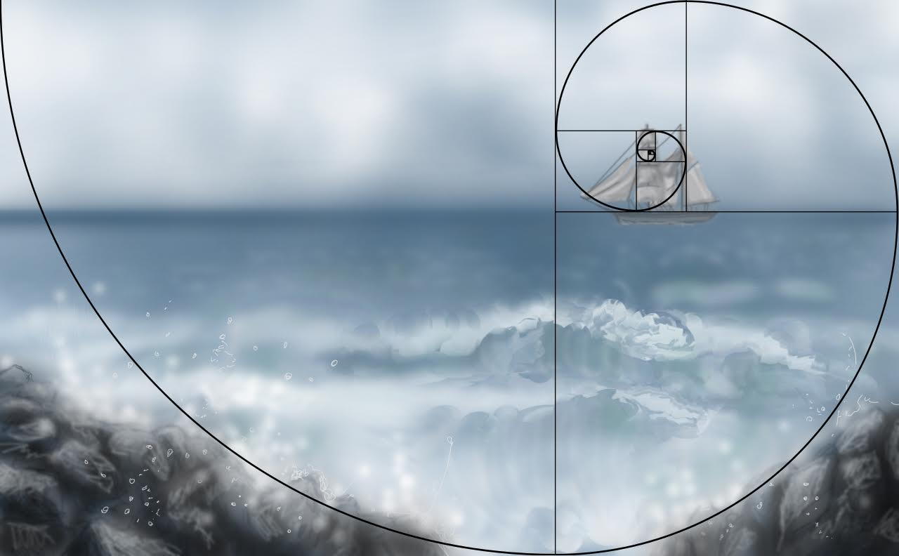

Slide 50



Slide 51



Slide 52

Page 94

Slide 53

Page 94

Slide 54


Page 93

Slide 55


Slide 56


Slide 57

Cropping a photo as a Golden Rectangle
First ask: Where is the visual center of gravity?

Slide 58

Identifying the visual center of gravity automatically shows you
how to find the Golden Rectangle around it!

Slide 59


Slide 60


Slide 61

Page 97

Slide 62


Slide 63

Museum of the Golden Ratio
http://www.museumofthegoldenratio.org/artists__contemporary.htm

Slide 64


Slide 65
Homework?

